Slide 1
Maths
Unit 6 – Fractions and Percentages.
22.09.2026
WALT:
6Nf.01: Understand that a fraction can be represented as a division of the numerator by the denominator.

Slide 2



WALT: Understand that a fraction can be represented as a division of the numerator by the denominator.
I can represent division as a fraction.
I can complete a table that shows the relationship between division and fractions.
I can explain to a grade 4 the relationship between fractions and division.

Slide 3
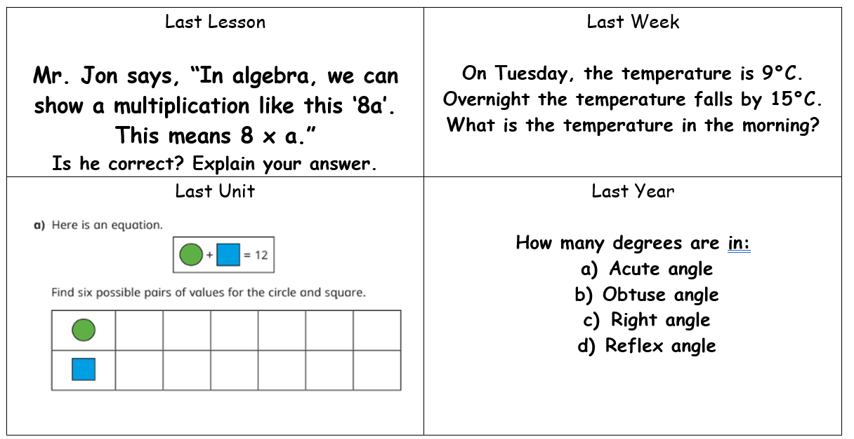
Retrieval Practice
WALT: Understand that a fraction can be represented as a division of the numerator by the denominator.

Slide 4

Starter – Which of these is the odd one out? Why?
WALT: Understand that a fraction can be represented as a division of the numerator by the denominator.
Eight divided by four.
$$\frac{8}{4}$$
2
8 ÷ 4 =

Slide 5


Write a number sentence to show the calculation represented below.
WALT: Understand that a fraction can be represented as a division of the numerator by the denominator.
Three pizzas shared between four people.
3 ÷ 4 =

Slide 6
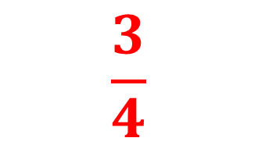
Write a number sentence to show the calculation represented below.
WALT: Understand that a fraction can be represented as a division of the numerator by the denominator.
What fraction of a pizza will each person receive?
$$\frac{3}{4}$$

Slide 7

From this example we can see that:
WALT: Understand that a fraction can be represented as a division of the numerator by the denominator.
$$\frac{3}{4}$$
3 ÷ 4 =
is equivalent to
What similarities and differences do you notice between the number sentence and the fraction?

Slide 8

Here is another example:
WALT: Understand that a fraction can be represented as a division of the numerator by the denominator.
If I had 5 brownies and wanted to share them between 8 friends, how could it be represented?
$$\frac{5}{8}$$
5 ÷ 8 =
is equivalent to

Slide 9



Check your understanding
WALT: Understand that a fraction can be represented as a division of the numerator by the denominator.
Represent the divisions as fractions.
$$\frac{3}{8}$$
3 ÷ 8 =
$$\frac{2}{3}$$
2 ÷ 3 =
$$\frac{5}{9}$$
5 ÷ 9 =

Slide 10
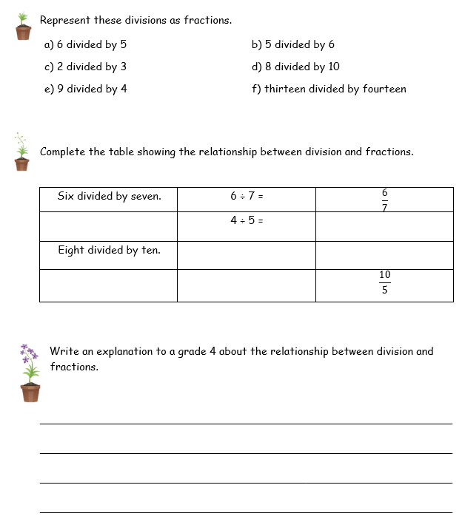
WALT: Understand that a fraction can be represented as a division of the numerator by the denominator.

Slide 11
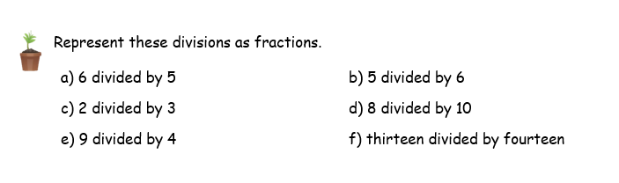






WALT: Understand that a fraction can be represented as a division of the numerator by the denominator.
$$\frac{5}{6}$$
$$\frac{6}{5}$$
$$\frac{2}{3}$$
$$\frac{8}{10}$$
$$\frac{9}{4}$$
$$\frac{13}{14}$$

Slide 12
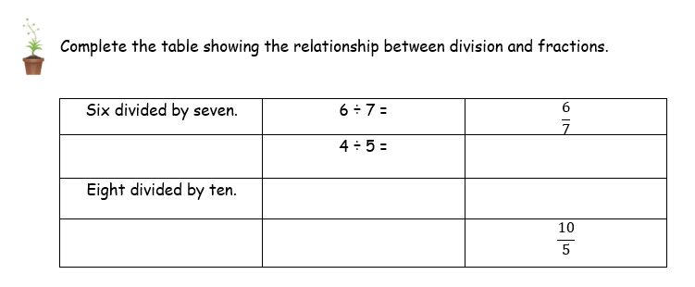


WALT: Understand that a fraction can be represented as a division of the numerator by the denominator.
Four divided by five
$$\frac{4}{5}$$
8 ÷ 10 =
$$\frac{8}{10}$$
Ten divided by five
10 ÷ 5 =

Slide 13
WALT: Understand that a fraction can be represented as a division of the numerator by the denominator.
I can represent division as a fraction.
I can complete a table that shows the relationship between division and fractions.
I can explain to a grade 4 the relationship between fractions and division.

Slide 14
Plenary -
WALT: Understand that a fraction can be represented as a division of the numerator by the denominator.
Which is greater ½ of $15 or ¼ of $40?

